Slide 1
Sentiment Analysis in Azure Databricks and Power BI with R Libraries
Dawn Marie Daras, Technical Solutions Professional
05 November 2018

Slide 2

Agenda
Azure Databricks and R
#1 Sentiment Analysis in Public Sector
#2 Azure Databricks
#3 Sentiment Analysis Using R Libraries in Databricks
#5 Power BI Visualization R

Slide 3
Sentiment Analysis in Public Sector

Slide 4

Sentiment Analysis in Public Sector
1) Sentiment analysis of text data –
Customer segmentation
Disease outbreaks
Sentiment regarding policies or legislation
Sentiment of special interest groups, protest groups, or potential events of concern
Flash mobs
Fraud/Money laundering/Criminal network detection
2) Using Social Media Analytics to Cut Off Sources of Criminal Activity
3) Case Study Using Social Media Analytics

Slide 5
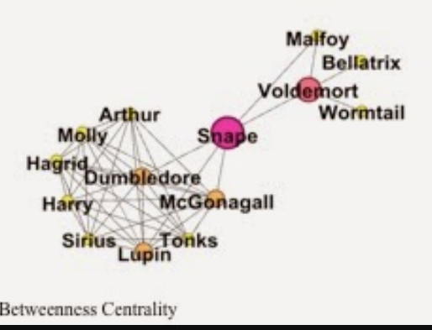
Sentiment Analysis in Public Sector- 2
Sources of data –
Social media (Facebook, Instagram, Twitter, YouTube, etc)
Reddit, blogs, chats, webpages, documents, and other public forums
Surveys, news articles, any text document
Applications in HR, AML, crowd control, customer segmentation, counterfraud, education, public image, policy enactment, funding, etc
Combined with Social Network Analysis (SNA) very powerful things can happen
Social Media Revolution
United Breaks Guitars
Norman AI
200 Tweets Can Predict Your Personality
It was widely reported that within 4 weeks of the video being posted online, United Airlines' stock price fell 10%, costing stockholders about $180 million in value.

Slide 6
Azure Databricks

Slide 7
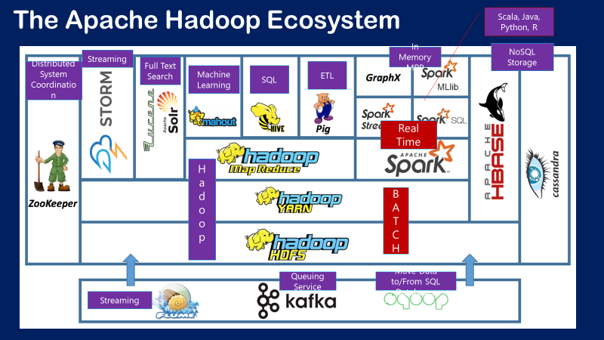

Slide 8
Apache Spark
An unified, open source, parallel, data processing framework for Big Data Analytics
R Language is not Supported by Spark (directly)
Spark SQL
Interactive Queries
Spark MLlib
Machine Learning
Spark Streaming
Stream processing
GraphX
Graph Computation
Spark Unifies:
Batch Processing
Interactive SQL
Real-time processing
Machine Learning
Deep Learning
Graph Processing
Spark Core Engine
Yarn
Mesos
Standalone Scheduler
Spark MLlib
Machine Learning
Spark Structured Streaming
Stream processing
R Packages SparkR and SparklyR Wrap the Spark API

Slide 9
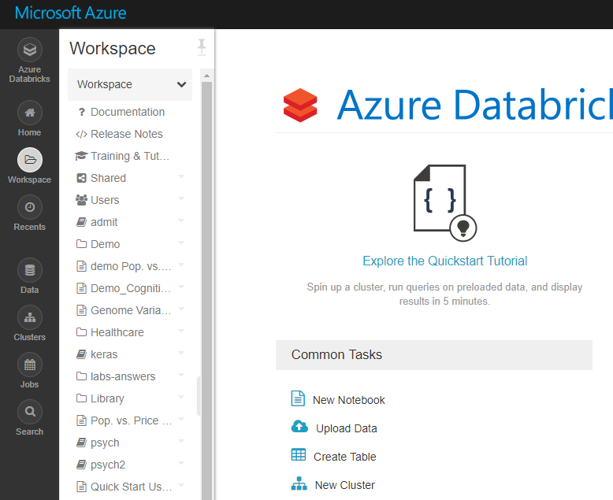
Azure Databricks R Language Deep Dive
Within Databricks, you spin up your own spark cluster, create notebooks in Scala, Python, R or SQL
Upload Data to a table or connect to outside sources such as Azure storage containers
Utilize documentation and training/tutorials

Slide 10
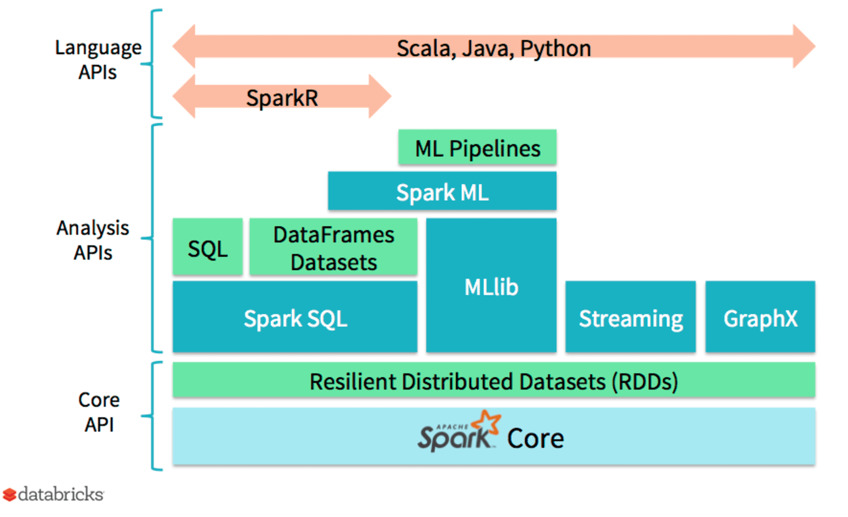
SparkR – What Do We Get?
Increased Support with Releases
https://databricks.com/blog/2016/12/28/10-things-i-wish-i-knew-before-using-apache-sparkr.html

Slide 11
Sentiment Analysis Using R Libraries in Databricks

Slide 12

Sentiment Analysis with R in Databricks
Fork from Github
Link
Data
Instructions
Case study

Slide 13
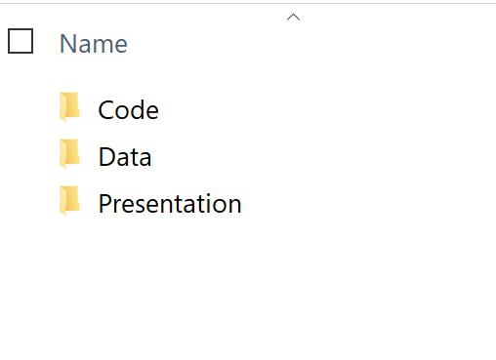
Materials Provided
In Github there are three folders
In the Code folder you will find the .dbc or the Databricks code file
You will also find an R file called Rsentimentlibraries which writes out the AFINN and nrc libraries which are the csv files in the Data folders
In the Data file you will find the three .csv files to upload to Databricks: afinn.csv, enron_words.csv, and nrc.csv and the two files that will be uploaded for PowerBI, enron_tidy_pol.csv and enron_bing.csv, one will be accessed through odbc
In the Presentation Folder is this Presentation, which contains the instructions

Slide 14
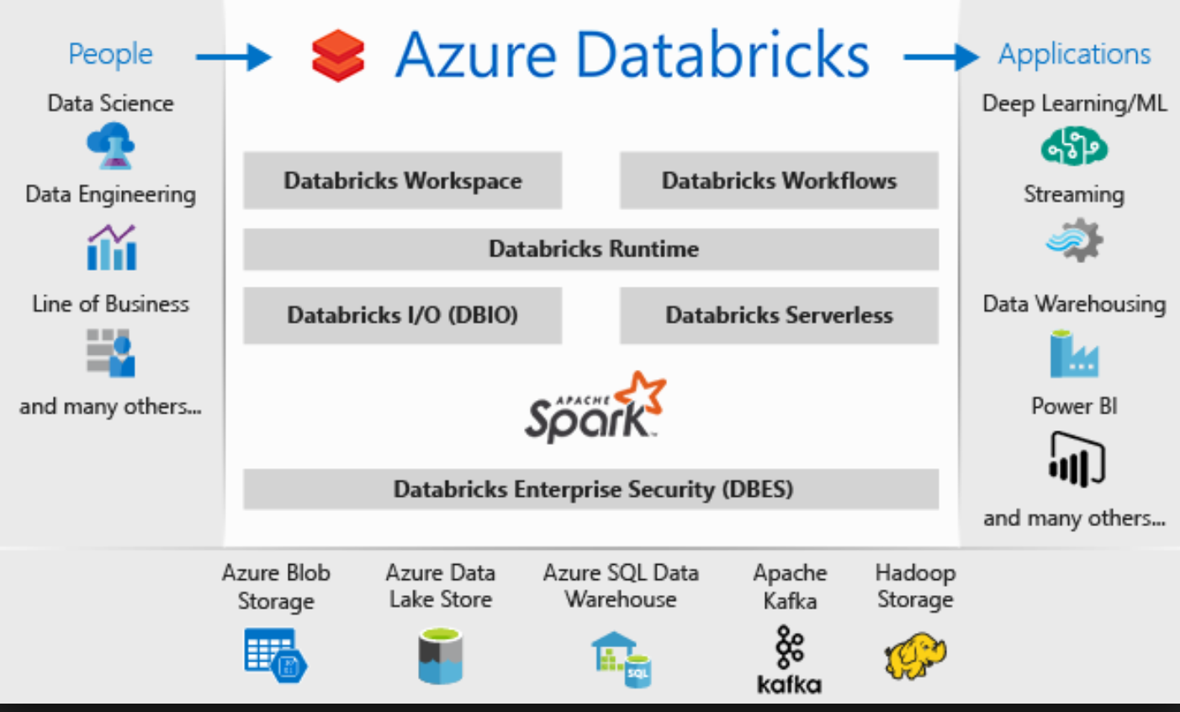
Creating Databricks Instance in Azure
First sign up for free Azure trial
Then sign up for Databricks Instance Databricks Instructions
Follow these instructions to create your first cluster:
Cluster creation instructions
Follow these instructions for importing the .dbc or Databricks notebook:
Importing Databricks Notebook Instructions

Slide 15
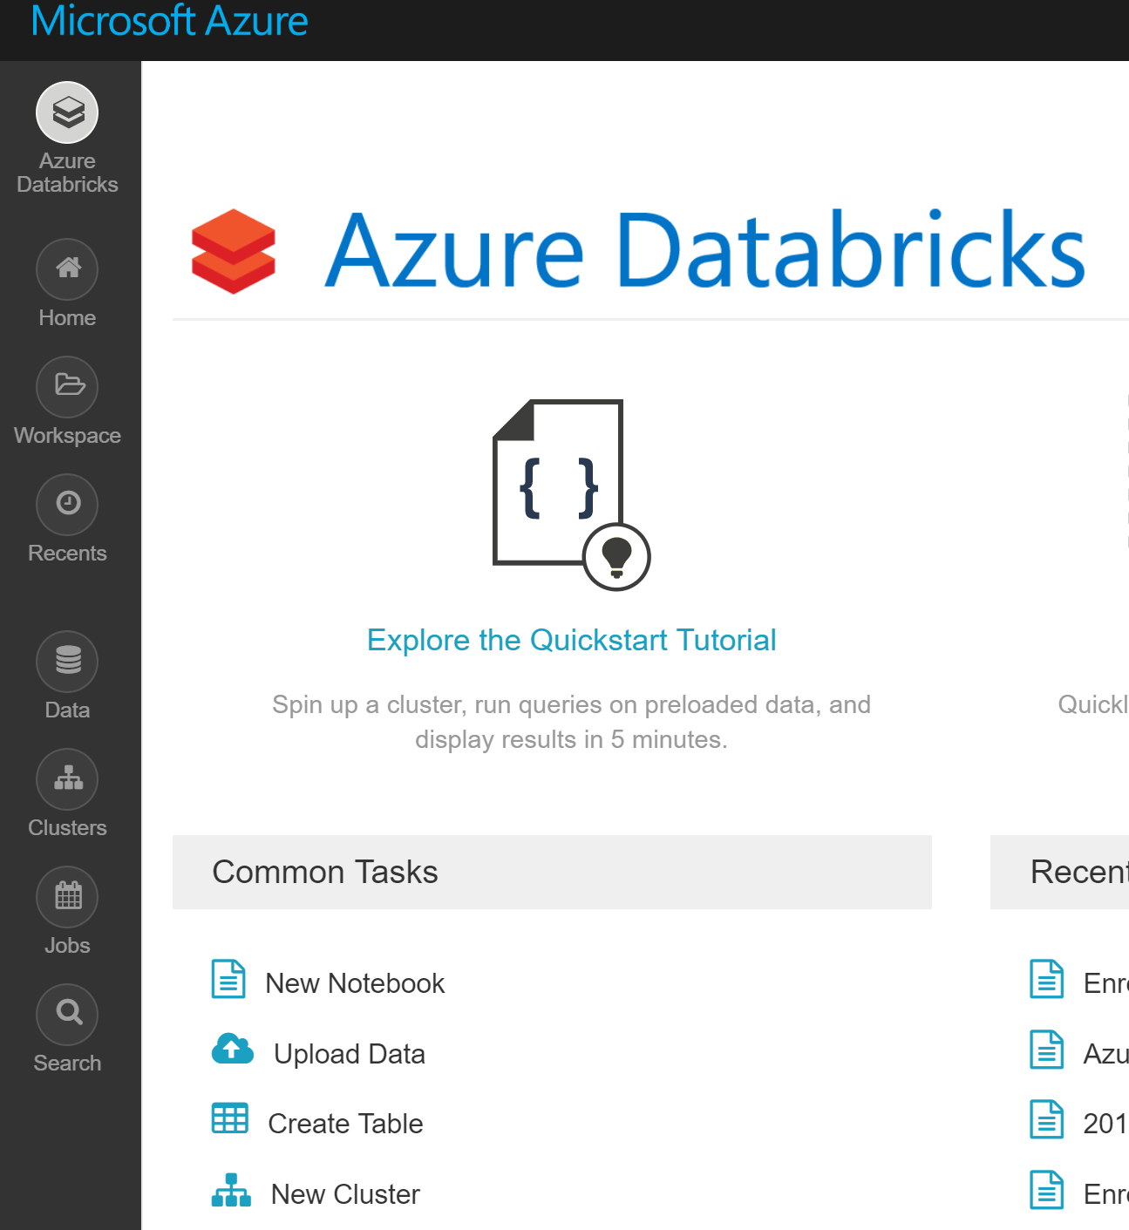
Uploading Data to Databricks
In the Data Folder are Two csv Files
Upload these to Databricks:
The top Azure Databricks icon, click on the tasks at the bottom:
“Create Table”
“Browse”
Then direct to the folder that stores the Data
Upload enron_words.csv, nrc.csv, and afinn.csv
Attach the .dbc notebook to the cluster and you can run each cell separately or run them all

Slide 16
PowerBI Visualization

Slide 17
R Visualizations in PowerBI – Demo and Lab Enron Sentiment
It involves
Data already prepped
R script and library (and dependencies
Installing PowerBI on local machine
Install PowerBI
Microsoft Open R installed on local machine
Microsoft Open R
Git link
Four sentiment visualization using Enron Internal Emal and R sentiment libraries
Directions

Slide 18
First PowerBI Visualization – The Canary in the Mine – Bing Library
R Scripts for PowerBI Instructions.
Only need to do this once:
Click on File: Options and Settings -> Options -> R Scripting
Make sure in the R script options "Detected R home directories" that the most recent version of your installed R is displayed.
Instructions for Visualization #1
1)Go to Get Data, choose Text/CSV, go to the folder that you have saved the data, select "enron_bing.csv"
load the data
2) Under visualizations click "R" it will ask you to enable R, click on that. An R script box will appear.
3) on the right hand side, under FIELDS, click on the fields "docID" and "polarity", in your R script editor an R dataframe
called "dataset" will now have been created with these two variables
4) paste the following code in the empty portion of the R Script Editor:
library(ggplot2)
ggplot(dataset, aes(docID, polarity)) +
geom_smooth() +
geom_hline(yintercept = 0, color = "red") +
ggtitle("Enron Emails Chronological Polarity“)
There is a small triangle in a circle above the R script window – this is your “run” button. Click this.

Slide 19
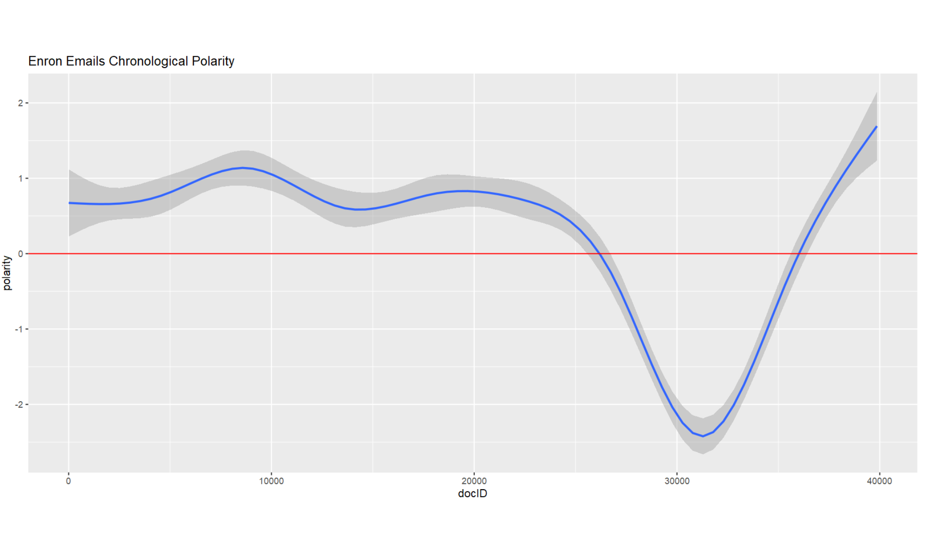
First PowerBI Visualization – The Canary in the Mine, p.2
As you can see for the most of the mail documents, the sentiment among the executives to each other is positive
But few of the emails with docID near 30000 has some negative sentiments as well.
This phenomenon is again worth analyzing to find out the exact reason behind this negative sentiment.
The next few visualizations will show us.

Slide 20
Second PowerBI Visualization – Polarity of Sentiment – Bing Library
Instructions for Visualization #2
1)Go to Get Data, choose Text/CSV, go to the folder that you have saved the data, select "enron_tidy_pol.csv"
load the data
2) Under visualizations click "R" it will ask you to enable R, click on that. An R script box will appear.
3) on the right hand side, under FIELDS, click on the fields “pol,” “word,” and "polarity", in your R script editor an R dataframe
called "dataset" will now have been created with these two variables
4) paste the following code in the empty portion of the R Script Editor:
library(ggplot2)
ggplot(
dataset,
aes(reorder(word, polarity), polarity, fill = pol)) +
geom_bar(stat = "identity") +
ggtitle("Enron Emails: Sentiment Word Frequency") +
theme(axis.text.x = element_text(angle = 90, vjust = -0.1))
There is a small triangle in a circle above the R script window – this is your “run” button. Click this.

Slide 21
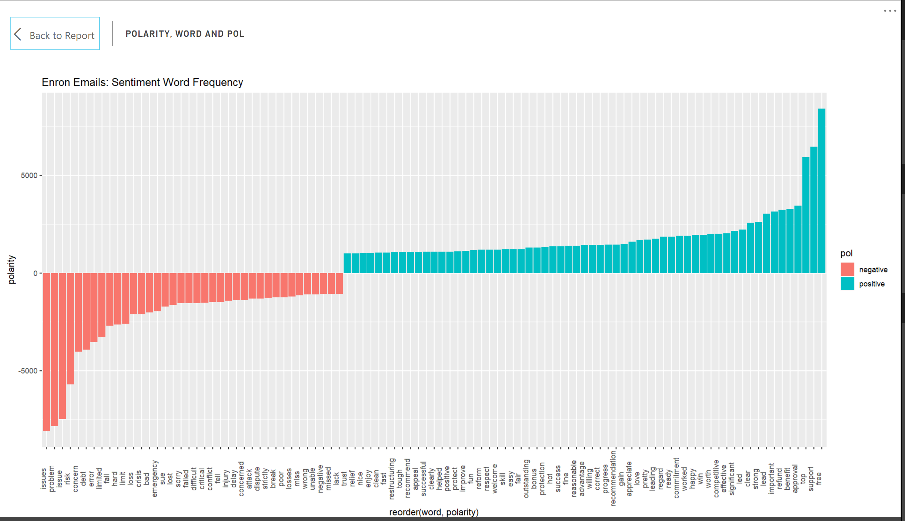
Polarity of Sentiment in the Emails - Visualization

Slide 22
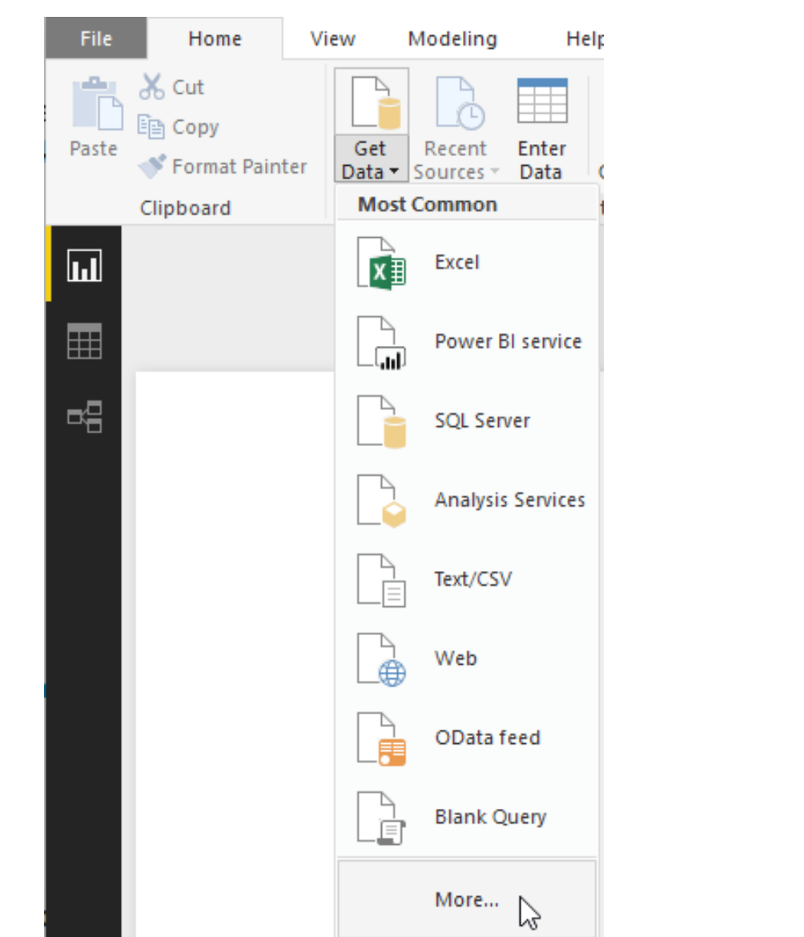
Third PowerBI Visualization – Enron Radar Chart- NRC Library & ODBC to Power BI
Instructions for Visualization #
The last table produced from the .dbc is enron_nrc2.csv
Using an odbc connection, we are going to connect PowerBI to grab this data and do a radarchart visualization with this output
Here is the link for the instructions:
Go to Get Data -> More ->Other ->Spark -> Connect – put in the server connection string that you copied during following the PowerBI ODBC Connection to Databricks Instructions
Select the enron_nrc2.csv dataset
PowerBI ODBC Connection to Databricks

Slide 23
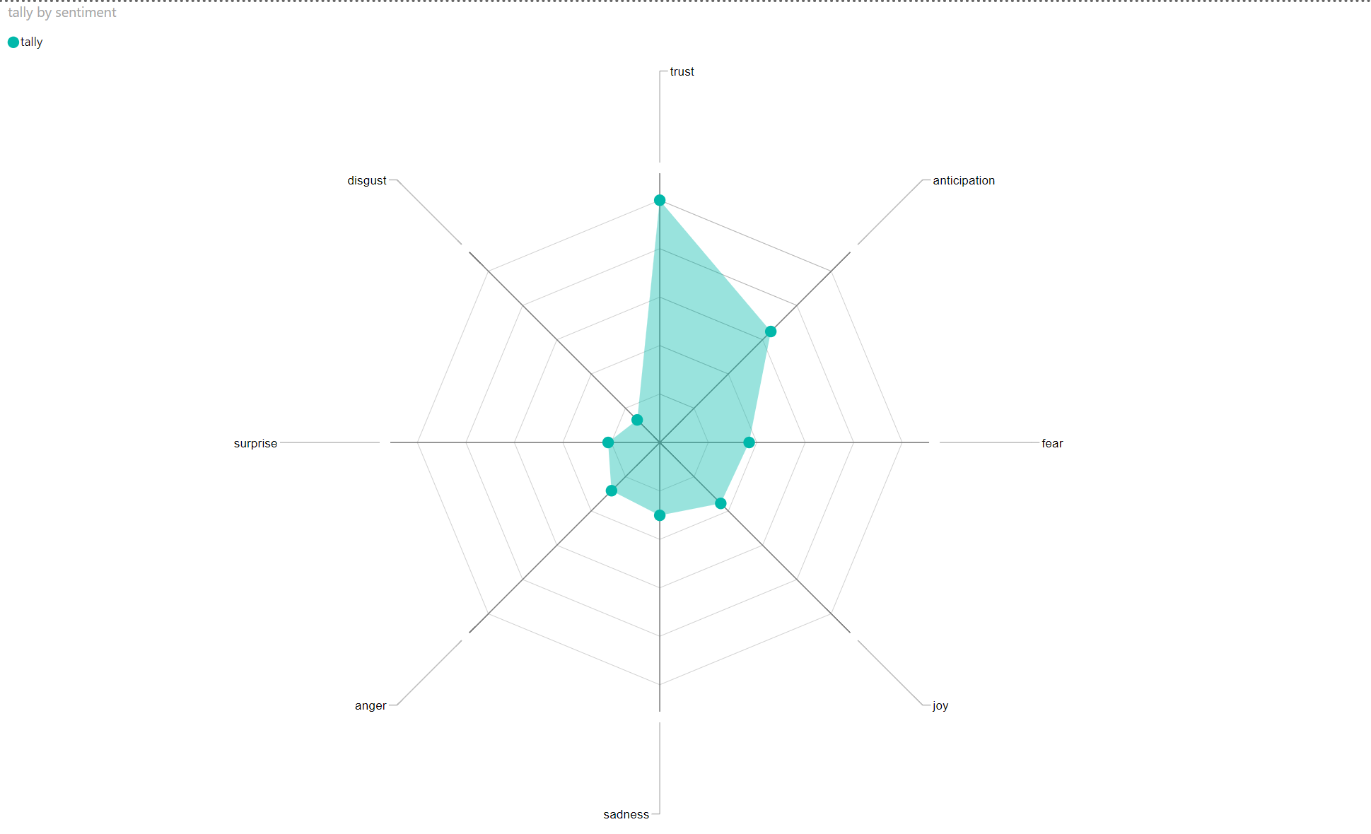
Third PowerBI Visualization – Enron Radar Chart- NRC Library & ODBC to Power BI, part 2
6) Under Visualizations, click on the elipses and import custom visualizations from the Marketplace
7) Search for and add “radar chart”
8) Under “Fields” click on both “sentiment” and “tally” your radar chart should be produced.

